Slide 1
The Walt Disney Company's Stock: Buy, Hold or Sell?
Case Study Report

Slide 2

Introduction
Antonia Crowley, a portfolio manager at Century 23 Investment Company, was reviewing the recently released fourth quarter and full fiscal year earnings report of The Walt Disney Company, commonly known as Disney.
The Walt Disney Company was founded in 1923 and is now a leading company in the entertainment industry. It is involved in various businesses, including movie production, streaming, and parks and resorts development. Disney’s stock had delivered a relatively strong performance in the last three years, outperforming media conglomerates Viacom Inc. (Viacom) and Comcast Corporation (Comcast), although underperforming Netflix.
November 7, 2019

Slide 3

Problem Identification
The main question of this case study is whether the Century 23 Global Fund should hold its current position in Disney’s stock, buy more, or sell.
To achieve the final answer, we will study the economic environment and the entertainment industry by analyzing the financial information about Disney and its peer companies, including: latest balance sheets, income statements, cash flow statements, financial ratios, comparative evaluation metrics and expectations of future performance.

Slide 4



Market Context
Media Networks
Parks/Resorts
Studio Entertainment
In the US, TV subscription revenue was expected to fall by 2.9% annually until 2023. However, the video streaming sector’s revenue was expected to grow 4.2% annually until the same year.
The spending on theme parks had been increasing at a rate of 5% per year. Park attendance was expected to grow at a rate of 3.8% per year through 2022.
Revenue grew 3.8% in 2019 and was expected to grow 9% in 2020. However, the online streaming platforms were starting to finance their own movies, creating a battle with the traditional film industry.

Slide 5
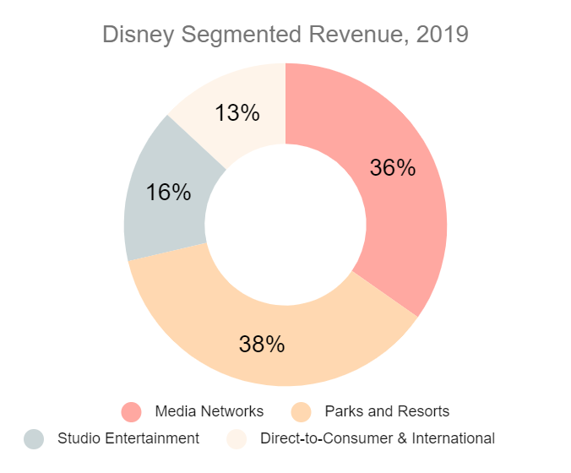
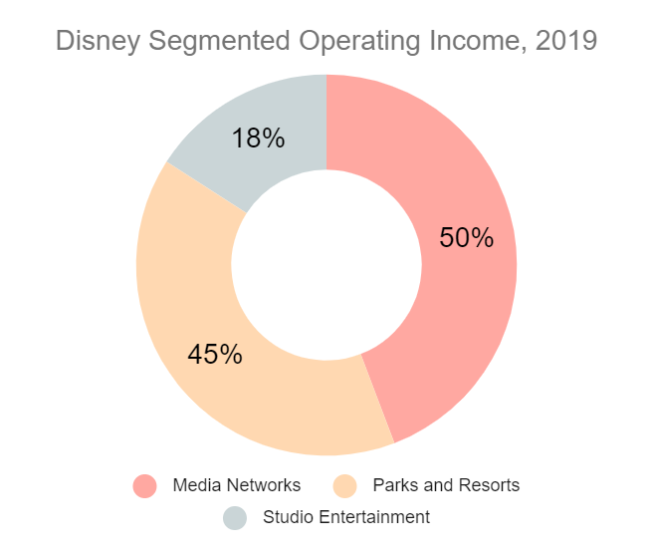
Market Context
Disney’s revenue comes mostly from the Media Networks and the Parks and Resorts segments, which represent, together, 74% of all the company’s revenue.
The company’s operating income is generated by the three main segments, Media Networks, Parks and Resorts and Studio Entertainment. The Direct-to-Consumer and International segment has generated a loss in operating income in 2019, hence why it is not represented in the pie chart.

Slide 6
Q1. Consider the strategy used by Century 23 Global Fund. What key criteria should Crowley apply when making her investment decisions?
The Century 23 fund uses the GARP (growth at a reasonable price) strategy in most of their investments. Considering this, Crowley should consider the following criteria when making her decisions.
Financial Statements | Crowley should perform a full financial analysis, based on the company’s balance sheet, income statement, statement of cash flow and financial ratios
Market Status | A market analysis should also be performed, to understand how it works and in which state the target market is currently in. The weaknesses and strengths of the target industry should also be analysed.
Competitor Analysis | The main competitors should be discovered and analysed.
PEG Ratio | The GARP strategy uses this ratio as an indicator for good investments. If a company’s PEG ratio is below 1, then it is likely a promising GARP candidate.
Company Stocks and Previous Growth | The GARP strategy is based on identifying stocks that show a consistent earning growth above market levels while trading at a reasonable price. Therefore, the price of the stocks and the company’s growth should also be taken into account

Slide 7
Q2. Size up the economy, as well as the media and entertainment industry. What are the growth prospects, competitive position, and key success factors?
Media Networks | TV subscription revenue was expected to fall by 2.9% annually to $81.8 billion by 2023, due to rise of video streaming Global revenue was forecast to increase 4.2% annually to $28.2 billion by 2023, which would account for 16 per cent of the digital media market and the number of users will grow 5% annually Embracing and exploring new technologies (IoT and higher quality content - 4K)
Parks and Resorts | With the explosion of the experience economy driven by the millennials, the spending on theme parks had recently been increasing at an annual rate of 5% to $44.8 billion and the park attendance was expected to grow at an annual rate of 3.8% through 2022 The way of growing in this segment is through the creation of highly immersive environments that integrate the latest technology, like virtual reality, and provide unique experiences to the park attendees Many theme parks and resorts were being built or renovated worldwide
Studio Entertainment | Industry revenue grew 3.8% in 2019 to $103 billion and was forecast to increase at an annual rate of 9% in 2020 The use of new technologies, like the full frame look, providing new experiences to the users As distribution became simpler and more affordable, an increasing number of independent filmmakers entered the industry.

Slide 8
Q2. Size up the economy, as well as the media and entertainment industry. What are the growth prospects, competitive position, and key success factors?
Media Networks | Consumers are shifting away from traditional TV to online content streaming Battle between cable TV providers and online streaming platforms has been intensifying in the previous years Streaming platforms seem to have the upper hand currently, but TV providers are innovating to regain some control over the market
Parks and Resorts | Fast-growing segment, has attracted many companies in the last few years Many parks and resorts are being built or renovated worldwide The rush to invest in parks and resorts has increased the competitiveness of the segment, which is now very high
Studio Entertainment | Difficulty to predict “hit movies” leads to a certain instability in the segment, allowing smaller companies to enter it. Online streaming platforms are starting to produce and invest in their own original movies, which created an intense battle between them and the traditional studio entertainment industry.
Notes:
Consumers shifting away from traditional TV to online streaming content has intensified the battle between the two sectors. Currently, online streaming services have the upper hand, but TV providers are starting to innovate to regain some control over the market.

Slide 9
Q2. Size up the economy, as well as the media and entertainment industry. What are the growth prospects, competitive position, and key success factors?
Disney | Is present in many segments within the Media and Entertainment industry Big company with a lot of recognition and stabilized across many sectors of the industry
Netflix | One of the first online streaming platforms that was able to gather a loyal and strong audience Started to diversify its operations by getting into the studio entertainment segment
Comcast | Has the most diversity in its operations from the four companies since it is also present in the telecommunications segment, providing both internet and cable TV subscriptions Owns some of the most viewed TV channels globally, like the Sky network. Like Disney, Comcast is a company that already has a lot of recognition in the market
Viacom | Attracted TV subscriptions from over 180 countries and 46 languages Currently merged with CBS, obtaining the largest viewership share in the US Owns popular brands, such as Nickelodeon and MTV
Notes:
Consumers shifting away from traditional TV to online streaming content has intensified the battle between the two sectors. Currently, online streaming services have the upper hand, but TV providers are starting to innovate to regain some control over the market.

Slide 10
Q2. Size up the economy, as well as the media and entertainment industry. What are the growth prospects, competitive position, and key success factors?
Having a diversified area of operations
Dilute company earnings across multiple sectors
In the case of a segment suffering big losses globally, the other segments help keeping the company healthy
Online Streaming
The decline in traditional TV audiences opens a window for online streaming platforms to grow
Hit Movies
It is important that the movies produced become “hits”, otherwise companies could lose high amounts of money
Difficulty to predict “hit movies” increases the risk in the movie industry
Economic Status of the US
US is the biggest market for this industry
The US economy is currently in a good shape, but a recession might still occur, although unlikely
Studio Entertainment

Slide 11
Q3. How would you evaluate Disney’s financial performance, both on an absolute basis and relative to its peers?
Valuation | High valuation for a Media and Entertainment company 108 billion dollars increase from 2018 to 2019 (possibly due to the acquisition of TFCF)
Profit Margins | Gross profit margin decreased from 45% (2017) to 39% (2019) Net profit margin saw a 5% increase in 2018, but decreased 6% in 2019
Revenue | Growing above broad market levels Industry standard is 4.3% and Disney’s revenue grew 7.8% in 2018 and 17% in 2019
Short-Term Liquidity | Current ratio slightly above 1 Quick ratio below 1 The company could pay all its short-term obligations if needed, but would have to sell some assets that may not be easily converted into cash, like the inventory
Cash Conversion Cycle | Negative cash conversion cycle in 2019 It takes longer to pay suppliers than to sell the inventory No need to have operating cash, since suppliers support the company’s operations
Others | Both the return on equity and return on assets are decreasing
Notes:
Big decrease in cash from operation in 2019

Slide 12
Q3. How would you evaluate Disney’s financial performance, both on an absolute basis and relative to its peers?
Growth | Disney |  | Industry
 | 2018 | 2019 | 2018 | 2019
Revenue | 7.8% | 17.1% | 12.9% | 12.6%
Operating income | 6.1% | (19.4%) | 26.9% | 8.4%
Net income | 40.3% | (12.3%) | 70.2% | 0.1%
Looking at the industry standards, we can see that 2018 was a great year for the media and entertainment industry, which saw an increase of 70.2% in net income globally.
Compared to the industry, Disney achieved poor results, even though on an absolute basis they were decent. In 2019, Disney was able to beat the industry standard revenue level, but continued to be below the industry regarding both operating and net income.

Slide 13
Q3. How would you evaluate Disney’s financial performance, both on an absolute basis and relative to its peers?
 | Disney | Netflix | Comcast | Viacom
Net Income (% of revenue) | 15.89% | 7.59% | 12.04% | 12.06%
Operating Income (% of revenue) | 17.2% | 12.5% | 19.1% | 21.1%
Valuation | 302 231 | 132 803 | 305 928 | 18 020
Net Profit Margin | 15.89% | 7.49% | 11.45% | 12.06%
Cash Conversion Cycle | (20.4) | (4.8) | (72.3) | 121.5
Revenue Growth (2018-2019) | 17.1% | 19.5% | 14.7% | (0.8%)
Working Capital | 1945 | (1930) | (3 666.0) | 1 888.0
Disney has the highest net profit margin, net income and working capital among its competitors
Disney has the lowest cash conversion cycle
Disney and Comcast have similar valuations, which are much higher than the other two companies
Viacom is the only company with a negative value of revenue growth in 2019. All the others were able to grow their revenue

Slide 14
Q3. How would you evaluate Disney’s financial performance, both on an absolute basis and relative to its peers?
Other Considerations
From the statement of cash flow, we can see that Netflix relies on financing to grow, while Disney relies mostly on its own investments and operating income to support operations.
Even though Netflix’s revenue growth from 2018 to 2019 is only 2% higher than Disney’s, Netflix has been showing signs of very fast growth from previous years, obtaining a revenue growth of 35.08% from 2017 to 2018. However, it has also been showing signs of instability and volatility, with a high decrease in working capital and in the current ratio in 2019.
Viacom is a much smaller company and seems to be struggling to compete with the other companies. With a cash conversion cycle of 121 days, it relies heavily on cash to fund operations. With high current and quick ratios (compared to the others and the industry standards), Viacom seems to be following a conservative growth approach.
Comcast seems to have adopted a quite aggressive financial strategy, having both the current and quick ratios below 1. From the company’s balance sheet, we can see that the company has a lot of debt, more than twice Disney’s debt value, but less equity.
Disney and Viacom have the lowest PEG ratios out of the four companies.
Notes:
Overall, Disney is probably the most solid company financially. Although Netflix is the one growing the fastest, Disney seems to already have conquered a part of the market and seems to be well established in all its market segments.

Slide 15
Q4. How would you assess Disney’s prospects compared with the consensus analysts’ forecasted revenue and profits? How would you assess the future performance of its peers?
Disney expects to start bouncing back from the temporary loss in growth they suffered after the TFCF acquisition, which should start to generate revenue for the company after an initial consolidation phase. The forecasted revenue and profits show that this scenario is likely to happen.
From the forecasted revenue and profits, we can see that Disney is expected to continue its upward trend in revenue generation. In 2020, it is expected to generate 17.53% more revenue than in the previous year and 6.06% in 2021. Both the company’s Enterprise Value to Revenue ratio and the Price to Earnings ratio will also start to stabilize in 2020 and 2021, meaning the stocks' prices will approach their actual value. Although Disney is expected to suffer a loss in net income in 2020, decreasing around 21% compared to the previous year, it is expected to bounce back in 2021 with a net income growth of 16.6%.
Compared to its competitors, Disney is expected to be passed by all the others regarding its net income margin, even though it is expected to have the second-highest revenue growth in 2020 and 2021, only being passed by its biggest competitor, Netflix. Netflix is expected to increase its net income margin at a great rate, even though it won’t surpass Disney’s on an absolute basis, and will start to stabilize its stock price. Both Comcast and Viacom will achieve similar growth values, but on two very different scales.

Slide 16
Q4. How would you assess Disney’s prospects compared with the consensus analysts’ forecasted revenue and profits? How would you assess the future performance of its peers?
Disney expects to start bouncing back from the temporary loss in growth they suffered after the TFCF acquisition, which should start to generate revenue for the company after an initial consolidation phase. The forecasted revenue and profits show that this scenario is likely to happen.
Disney’s revenue is expected to continue growing, but the growth should slow down in 2021
With the decrease in revenue growth in 2021, Disney’s EBITDA and EBIT should also suffer at the same proportion
With the acquisition of TFCF, Disney will suffer a big loss in net income growth in 2020, due to TFCF’s consolidation, but after that phase, the company should start growing again and attain even bigger net income margins
 | Disney
 | 2020 | 2021
Revenue | 17.5% | 6.1%
EBITDA | 13.2% | 7.7%
EBIT | 27.5% | 11.3%
Net Income | (21.4%) | 16.6%

Slide 17
Q4. How would you assess Disney’s prospects compared with the consensus analysts’ forecasted revenue and profits? How would you assess the future performance of its peers?
 | Netflix |  | Comcast |  | Viacom
 | 2020 | 2021 | 2020 | 2021 | 2020 | 2021
Revenue | 21.8% | 19.0% | 5.3% | 1.5% | 3.4% | 2.7%
EBITDA | 45.8% | 37.4% | 6.7% | 2.8% | 0.6% | 0.7%
EBIT | 49.7% | 39.7% | 10.0 | 3.2% | 0.3% | 1.2%
Net Income | 63.3% | 53.5% | 9.8% | 5.9% | 10.6% | 5.1%
Netflix: Consensus analysts predict a great future for this company, showing huge rises in all presented parameters;
Comcast: Predictions show that this company grows at a small rate than Netflix or Disney and the values will not vary too much in coming years;
Viacom: Forecasted revenue is very similar, but we note that the net income grows significantly, so we can conclude that they are not making new investments, which could bring future problems in revenue.

Slide 18
Q5. In the place of Crowley in December 2019, what action, if any, would you take with respect to the Century 23 Global Fund’s position regarding Disney’s stock? Defend your position.
Safest
Medium Risk
Riskiest
Buy
Disney is a growing company with clear planning and investments for the future. It also attacks the various fronts of the entertainment industry.
It has no risk of going into bankruptcy and will most likely only grow in the next years.
Hold
Instability derived from the TFCF acquisition, can make the stock price to go down, but it is a long-term investment for the company which can eventually increase Disney’s value. Because of this it is a good choice to hold and wait to see what happens in the future.
Sell
The probability of Disney continuing its upward growth trend is high.

Slide 19
Hold, Buy or Sell - Recommendation
Disney’s PEG ratio is below 1 and the company has been growing above broad market levels, making it a good candidate for the GARP investment strategy. However, the acquisition of TFCF brought some financial instability to the company, which suffered a big operating income loss right after the acquisition. After analyzing the company’s financial status, and although the forecasts are positive, we recommend holding the stock and monitor the company’s evolution for some time. We believe this is a medium-risk action since Disney could perform very well after TFCF’s consolidation, but it avoids the big money loss that could happen in case the acquisition proves to not be an effective move.
Revenue Growth
Industry | Disney |  | Netflix |  | Comcast |  | Viacom
 | 2017-2018 | 2018-2019 | 2017-2018 | 2018-2019 | 2017-2018 | 2018-2019 | 2017-2018 | 2018-2019
4,3% | 7,79% ✔️ | 17,05%✔️ | 35,08%✔️ | 19,51%✔️ | 11,15%✔️ | 14,69%✔️ | (2,41%)❌ | (0,81%)❌

Slide 20

Authors
Class 3, Group 4
Beatriz Mendes, up201806551@edu.fe.up.pt
Bernardo Ramalho, up201704334@edu.fe.up.pt
Pedro Azevedo, up201806728@edu.fe.up.pt
Pedro Ponte, up201809694@edu.fe.up.pt
Tomás Fontes, up201806252@edu.fe.up.pt
Some of the calculations presented are available on the spreadsheet submitted on the sheets "Calculations", "Comparative Financial Ratios" and "Forecasted Revenue and Profit"

